Slide 1
Agentic Neuro
The Enterprise Repository & Manager-Gated Workspace
Presented by: Paramata Mohanchandramouli

Slide 2
"Bridging the gap between autonomous AI capabilities and strict enterprise security through manager-gated orchestration."

Slide 3

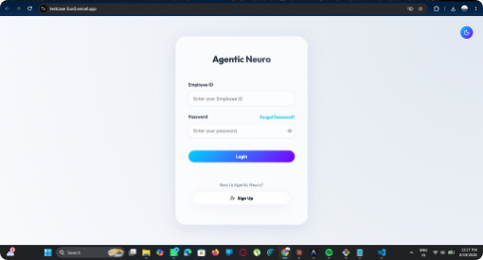
Secure Access & Identity
Unified Authentication Standardized Employee ID and password protocols integrated with your existing SSO enterprise identity provider.
Biometric Integration Optional Face ID locks add an extra layer of zero-trust security for sensitive managerial workspaces.
Adaptive Environment Seamless toggle between Light and Dark modes to accommodate individual developer and manager preferences.

Slide 4
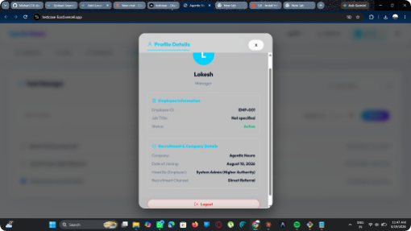
Role-Based Manager Profiles
Hierarchical Access Control Agentic Neuro relies on strictly defined organizational hierarchies. Profiles dictate exactly which data silos and agent logic a user can authorize or modify.
Managerial Privileges Managers (like Lokesh) possess the elevated privileges required to act as the "human-in-the-loop" for high-risk agent proposals within their designated teams.

Slide 5
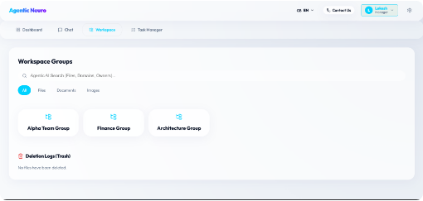
Isolated Workspace Groups
Categorized Hubs Divide organizational knowledge into secure groups (e.g., Alpha Team, Finance, Architecture) to prevent cross-contamination of agent context.
Centralized Search A powerful, AI-driven global search allows users to instantly query files, domains, and owners across permitted workspaces.
Secure Deletion Logs Maintain absolute data integrity with transparent trash and retention policies for compliance auditing.

Slide 6
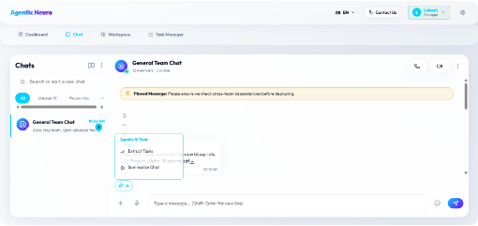
Context-Aware Tooling
Embedded Integration Agents aren't isolated bots; they live where your team works. Embedded directly within the General Team Chat, agents monitor conversations and cross-team dependencies.
On-Demand Tooling Users can invoke specialized Agentic AI Tools on-demand, such as instantaneously extracting action items from long threads or summarizing complex architectural discussions.

Slide 7
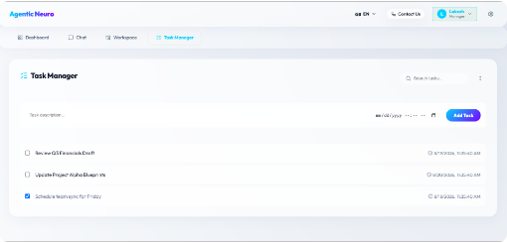
Intelligent Task Management
AI-Generated Backlogs Tasks extracted from blueprints and chat histories flow directly into a unified queue for managerial review.
Deadline Orchestration Schedule team syncs and assign strict timelines for financial reviews and project updates.
Action Accountability Clear visibility into pending versus completed tasks ensures that AI-recommended actions are successfully executed by human counterparts.

Slide 8
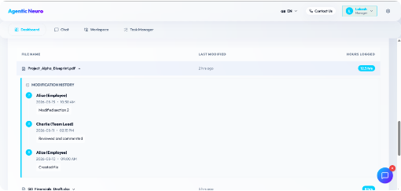
Enterprise-Grade Auditing
Immutable Modification History Every file interaction within the Agentic Neuro repository is meticulously tracked. The system records the exact timestamp, the user (or agent) responsible, and the nature of the action.
Compliance & Tracing From initial creation by an employee to managerial review and subsequent modifications, this timeline is critical for regulatory compliance and tracing logic failures.

Slide 9
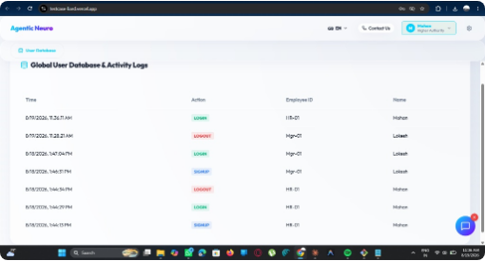
Global User Database & Activity Logs
Real-Time Monitoring Track enterprise-wide login, signup, and logout events instantly across the entire platform.
Identity Verification Cross-reference active sessions with employee IDs to maintain strict access control and prevent unauthorized breaches.
Comprehensive Logging Maintain an easily accessible and transparent record of all user sessions to simplify large-scale security audits.

Slide 10
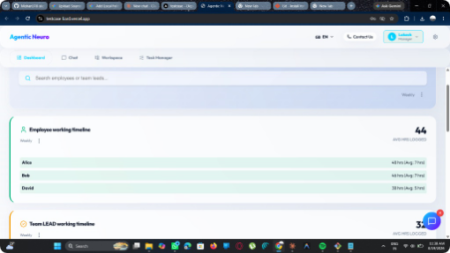
Team Activity Tracking
High-Level Monitoring Dashboard views aggregate hours logged across both standard employees and Team Leads.
Workload Balancing Quickly identify discrepancies in logged hours (e.g., Alice at 48 hours vs. David at 38 hours) to proactively manage burnout.
Resource Allocation Data-driven insights allow managers to dynamically assign AI agents to assist overloaded team members.

Slide 11
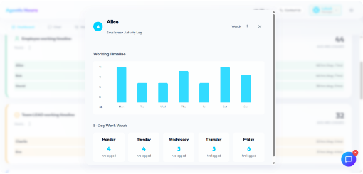
Deep Dive Analytics
Granular Performance Insights Beyond high-level averages, managers can interrogate specific activity logs. Visual bar charts plot daily exertion across the work week.
Operator Capacity This level of detail validates that human operators maintain the capacity required to effectively monitor, review, and gate the autonomous agents operating underneath them.

Slide 12
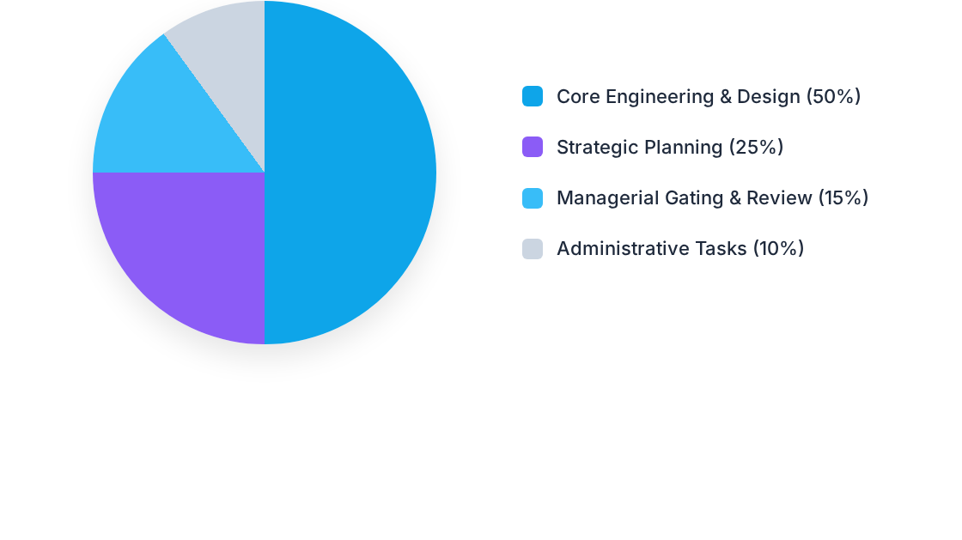
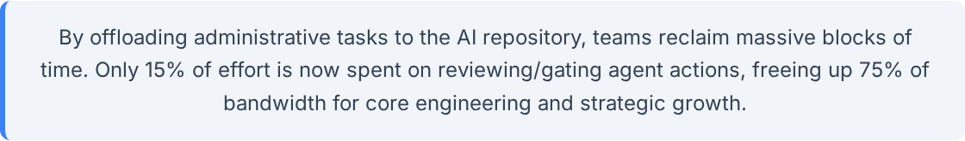
Impact on Productivity

Slide 13
Questions?
Thank you for exploring Agentic Neuro.
Agentic Neuro Platform Architecture

